Slide 1
The Camera and The Eye
A Brief History of Photography
A Brief History of Photography

Slide 2
Mirrors, which are used in cameras, were manufactured in Ancient Greece, circa 350 B.C.
A mirror is an object that reflects lighting a way that preserves much of its original quality subsequent to its contact with the mirror.
A Brief History of Photography

Slide 3
Aristotle notices and records the phenomenon of an image projected by a pinhole in a darkened room.
This idea that could easily be used to make a pinhole camera is known during 350 B.C.
So, why did it take 2,000 years to invent the camera?
A Brief History of Photography

Slide 4
Aristotle (344 B.C.-322 B.C.), Plato’s greatest student, teaches his discovery, so it can be forever remembered.
A Brief History of Photography

Slide 5
The temple at Delphi, Greece, c.566 B.C. houses the “Camera Obscura” that means “Dark Chamber.”
The Latin phrase, Camera Obscura is significant and will be used throughout the history of photography. The word Camera translates into chamber. The word, Obscura means dark. The real camera obscura is a room beneath this stone floor, where the oracles at the Temple of Apollo saw the future.
A Brief History of Photography

Slide 6
Inside, the oracles of Delphi gazed into silvery mirrors to see images form, while inhaling hallucinogenic gases.
The tripod chair sat over a volcanic vent and fissure that released gasses, which contain the same psychotropic substance found in glue sniffing. The oracles saw images form on the silver plate , which revealed prophecies that were sent from the God Apollo and given to the emperor, a God in human form.
A Brief History of Photography

Slide 7
Leonardo da Vinci, 1452-1519, studies nature to become a better painter and produces inventions.
Leonardo studies nature and anatomy to realistically draw and paint the human figure. At the same time, he tries to invent machines that imitate nature, such a flying machine and clocks to measure time.
A Brief History of Photography

Slide 8
Leonardo dissects corpses to study the human body
and records what he finds in his notebooks.
This leads to many discoveries which influence his designs,
and humanity…
…and photography.
A Brief History of Photography

Slide 10
The Camera and The Eye
Part Two
A Brief History of Photography

Slide 11
Leonardo’s study of anatomy allows him to produce masterpieces of drawing and painting.
A Brief History of Photography

Slide 12
Leonardo’s dissection of the eye allows us to understand it as never before.
A Brief History of Photography

Slide 13
The eye uses a lens, dark chamber, focusing screen, and photo sensitive material to produce an image.
A Brief History of Photography

Slide 14
Leonardo uses a lens, dark chamber and focusing screen inside his new invention, “The Camera Obscura.”
A Brief History of Photography

Slide 15
Leonardo uses this sketch to invent the camera obscura in 1492.
A Brief History of Photography

Slide 16
The room sized camera obscura in San Francisco.
A Brief History of Photography

Slide 17
Inside the camera obscura.
A Brief History of Photography

Slide 18
You could place a piece of drawing paper on the table and draw the projected image.
A Brief History of Photography

Slide 19
The image produced inside the camera obscura; this one is located in Europe.
A Brief History of Photography

Slide 20
Leonardo does this and traces the image. Over the years, it is a trade secret of master painters.
A Brief History of Photography

Slide 21
Photographic realism is achieved with paint on canvas used inside a camera obscura.
A Brief History of Photography

Slide 22
The shroud of Turin is said to the first photograph ever made by Leonardo inside a camera obscura, c.1490.
Leonardo is said to have used his own face to produce Christ’s face. The image is produced by exposing cloth soaked in light-sensitive silver salts inside the camera obscura. Watch the YouTube video of its recreation and decide for yourself.
A Brief History of Photography

Slide 23
Leonardo had used his face before to create at least one other masterpiece.
A Brief History of Photography

Slide 24
A portable camera obscura was invented next.
A Brief History of Photography

Slide 25
The portable camera obscura is used to produce drawings forever after its invention.
A Brief History of Photography

Slide 26
The camera obscura is taken to all corners of the earth to record its marvels.
A Brief History of Photography

Slide 27
The images made in the camera obscura are put into print
and information is disemenated around the world
A Brief History of Photography

Slide 28
From this window photography is invented when light-sensitive material is placed in this camera obscura.
A Brief History of Photography

Slide 29
The first photograph is produced in France during 1819.
Why did it take so long- -2000 years-- to create an image if all the items necessary had existed since ancient Greece?
A Brief History of Photography

Slide 31
Check out the
Compostion Slide show!

Slide 32
Human beings differ from other animals because they can make and use tools.
A Brief History of Photography
A Brief History of Photography

Slide 33
Light sensitivity
and the invention of photography.
A Brief History of Photography

Slide 34
Through direct observation man has discovered light sensitive materials in nature.
A Brief History of Photography

Slide 35
Plants will move their leaves to absorb the maximum amount of sunlight. This one closes up at night.
A Brief History of Photography

Slide 36
Observing nature, man has invented solar panels that move to absorb the most amount of sunlight.
A Brief History of Photography

Slide 37
Skin is also light sensitive, where the skin was covered it remained white & tanned when exposed to sunlight.
A Brief History of Photography

Slide 38
You may use your skin as photograph material. When will permanent photographic tattoos be invented?
A Brief History of Photography

Slide 39
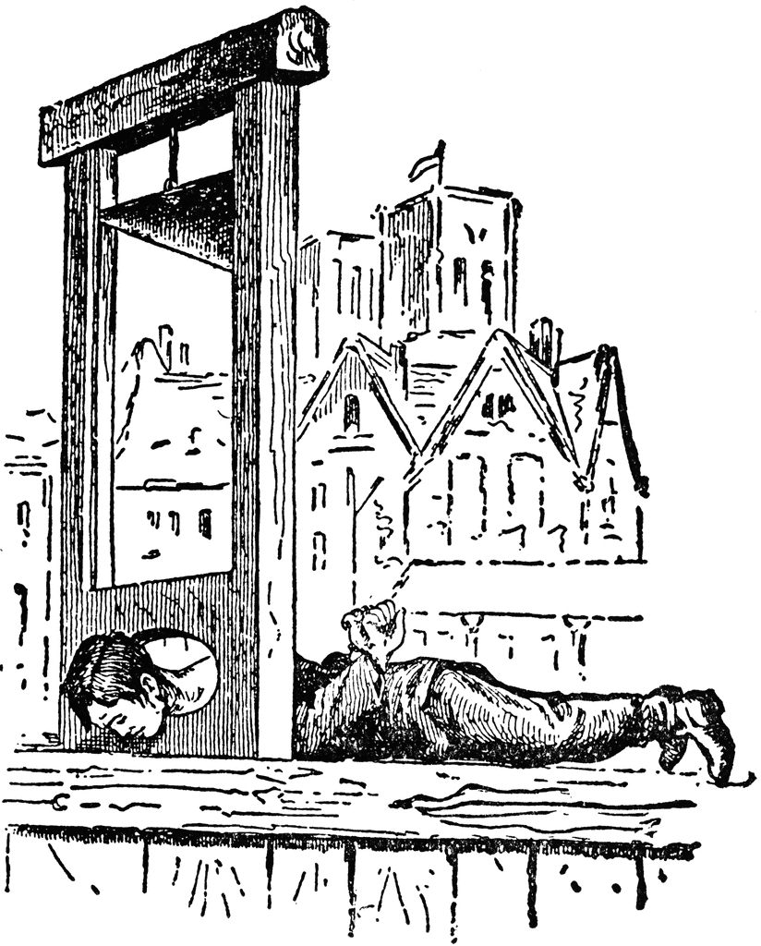
During the French Revolution it was observed that retinal image photos where created on the beheaded.
A Brief History of Photography

Slide 40
This retinal photograph was produced from a beheaded rabbit and mounted for display.
The image shows the last thing –a set of windows—that the rabbit viewed. This is the first fixed image on a light sensitive surface.
A Brief History of Photography

Slide 41
Hoping to fix an image, Nicephore Niepce now places light sensitive material inside this camera obscura.
A Brief History of Photography

Slide 42
After eight hours exposure, the first photograph is made in 1826-27.
A Brief History of Photography

Slide 43
Niepce dies before his process is fully resolved. As a result, this is a painting of him, not a photograph.
A Brief History of Photography

Slide 44
Louis Daguerre, 1787-1851, improves the process and in 1839 his Daguerreotype method of photography is born
In the end, Daguerre is credited with photography’s invention.
A Brief History of Photography

Slide 45
Daguerre’s first photograph produced for the government to prove his discovery.
The word photograph comes from the Greek word “phos” meaning light and “graph” meaning to write Hence, it literally means, “Light Writing,” which is appropriate because the photograph draws itself. In a sense, photographs are instant drawings that are precisely made with a scientific recording device.
A Brief History of Photography

Slide 46
A man having his boots shined and the bootblack are the first people ever photographed.
Although many people pass them on the sidewalk, none stood still long enough to be recorded on the plate, except for these two men. The exposure time for this image was perhaps two minutes.
A Brief History of Photography

Slide 47
Today the same street is named after Daguerre.
A Brief History of Photography

Slide 48
William Henry Fox Talbot, 1800-1877, invents photography at the same time in England.
A Brief History of Photography

Slide 49
After coating paper with light sensitive silver salts, he sets objects on it and exposes the paper to light.
As seen with the farmer’s tan, where the object covered the paper it remained white and where touched by light, the paper turned dark.
A Brief History of Photography

Slide 50
The exposures take hours and only inanimate objects can be photographed.
Talbot called his process, which uses a paper negative, the “calotype.” However, with long exposure times and fuzzy images, it never reached the popularity of the Daguerreotype.
A Brief History of Photography

Slide 51
The use of a paper negative creates a fuzzy image.
On the left you see the paper negative, which is then placed atop another sheet of sensitized paper. When exposed to light, the negative produces a positive print. Also, you could print an endless number of prints from a negative.
A Brief History of Photography

Slide 52
Daguerre’s images are sharp and detailed. However, using the process is as deadly as handling a poisonous spider.
A Brief History of Photography

Slide 53
In 1839, Robert Cornelius produces this self-portrait. This is the first Daguerreotype made in America.
A Brief History of Photography

Slide 54
Soon after Daguerreotypes are made all over America. This is the poet, Edgar Allen Poe, c.1840.
In the early years, photographs were experimental and expensive. Hence, scientific subjects, famous people, and views from exotic places where used to showcase the possibilities of this new invention. It was not until 1845 that average Americans could have their photograph made.
A Brief History of Photography

Slide 55
The art world reacts to photography and painter Paul Delaroche pronounces , “painting is dead.”
Reality could not be reproduced with more validity than through photography. Hence, all painted images are fiction and photographs are the truth. Painting never recovers and photography becomes an art.
A Brief History of Photography

Slide 56
Due to the toxic chemicals many photographers die. In the end, Talbot’s process is improved and used today.
After the Daguerreotype process is over, Talbot’s process was improved by creating an image on glass instead of paper. As a result, the wet-collodion process is invented in the 1850’s. Today, plastic replaces the glass.
A Brief History of Photography

Slide 57
First Assignment!!!
This assignment will teach students how the enlarger functions, and how to “effect” the photo paper.

