Slide 1
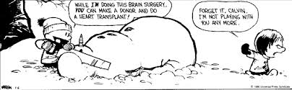
Learning Targets:
I can name most of my classmates.
I can name all of my classmates.
I can remember stuff from Beginning Photoe

Slide 2

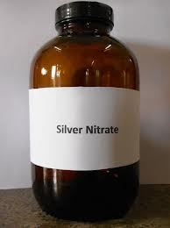
AdVanced ReCap…
What’d we learn in B&W PhoToe…
Hint: the answer ain’t “nuthin’ “
How did PhotOgraphicals develop?
…with the invention of light sensitive paper…

Slide 3
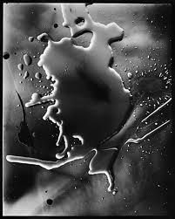
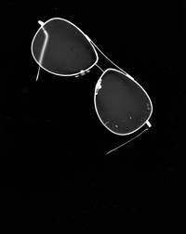
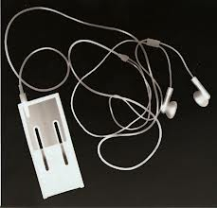
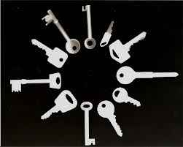
AdVanced ReCap…
Photo paper = photoGram crackers!...mmmmmmmm....

Slide 4
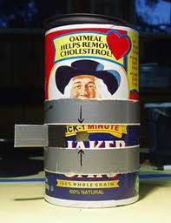
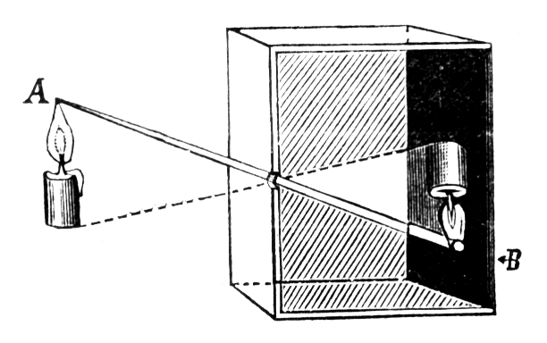
AdVanced ReCap…
The camera obscura…

Slide 5
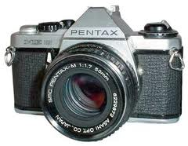
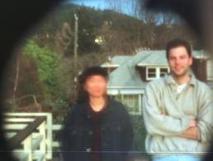
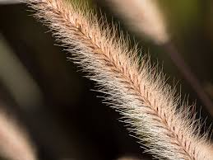

AdVanced ReCap…
35mm Camera!
How does a 35mm camera work?
First ya have ta focus the dang thing……

Slide 6
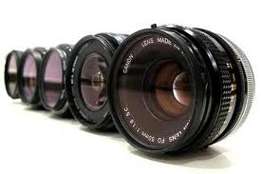
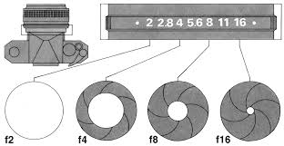
AdVanced ReCap…
How does a 35mm camera work?
…then the lens…
…F stops, aperture…

Slide 7
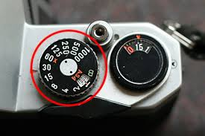
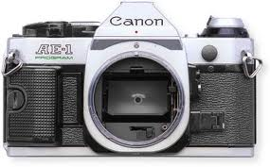
AdVanced ReCap…
How does a 35mm camera work?
…the shutter speed…

Slide 8
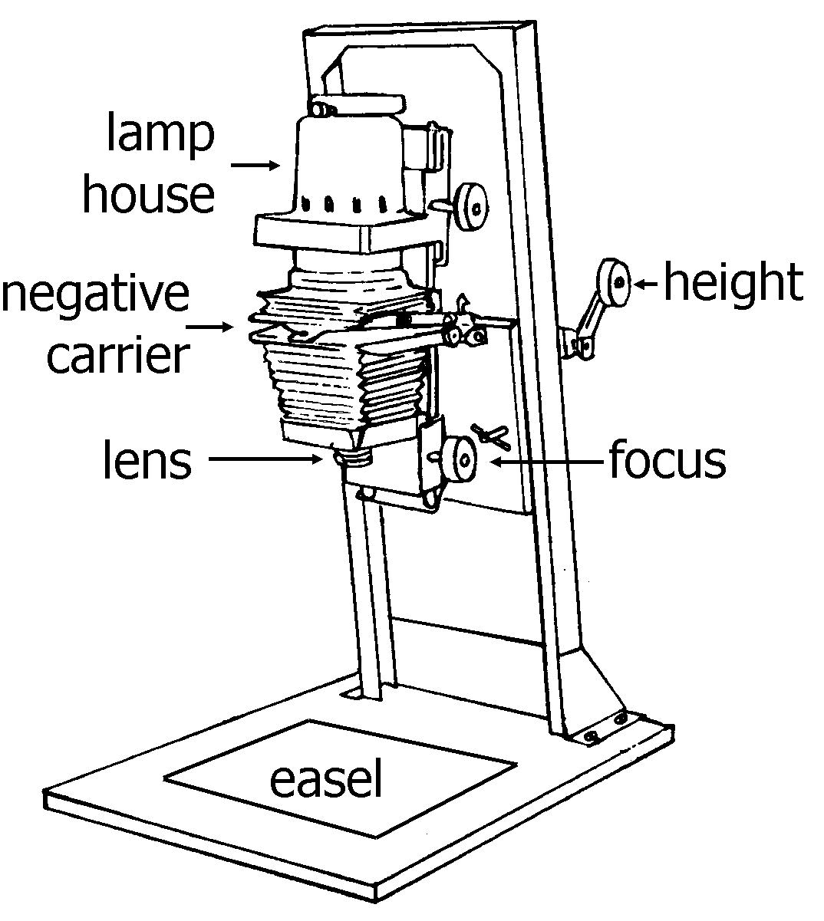
AdVanced ReCap…
Hey! What’s that thing called again?
g
e
N
L
A
r
R
E

Slide 9
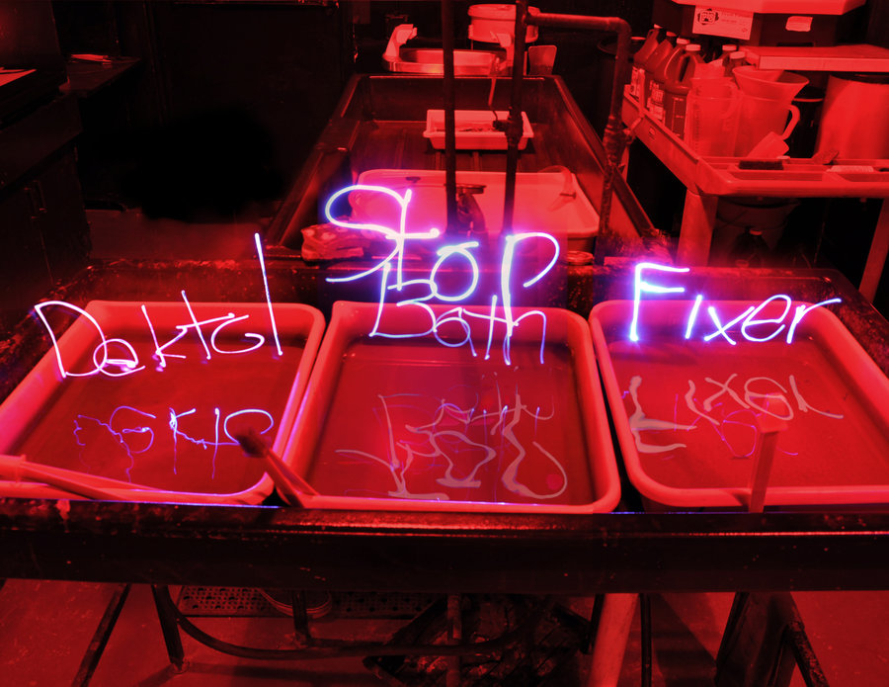
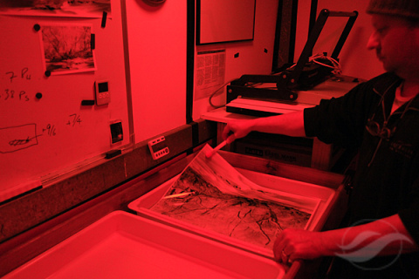
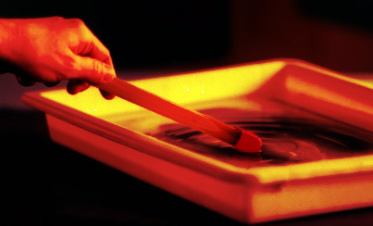
AdVanced ReCap…

Slide 10
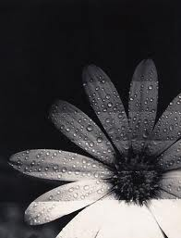
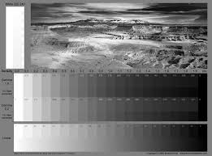
AdVanced ReCap…
Test print!

Slide 11

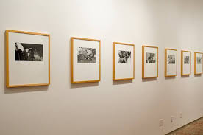
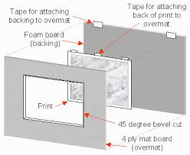
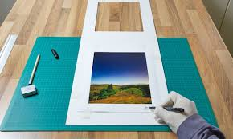
AdVanced ReCap…
Matting...

Slide 12
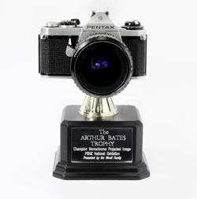
AdVanced ReCap…
Awards?

Slide 13


CHEEEEEEESE!

