Slide 1
When Art and Pride Collide
CS Advisory Object Art Project

Slide 2
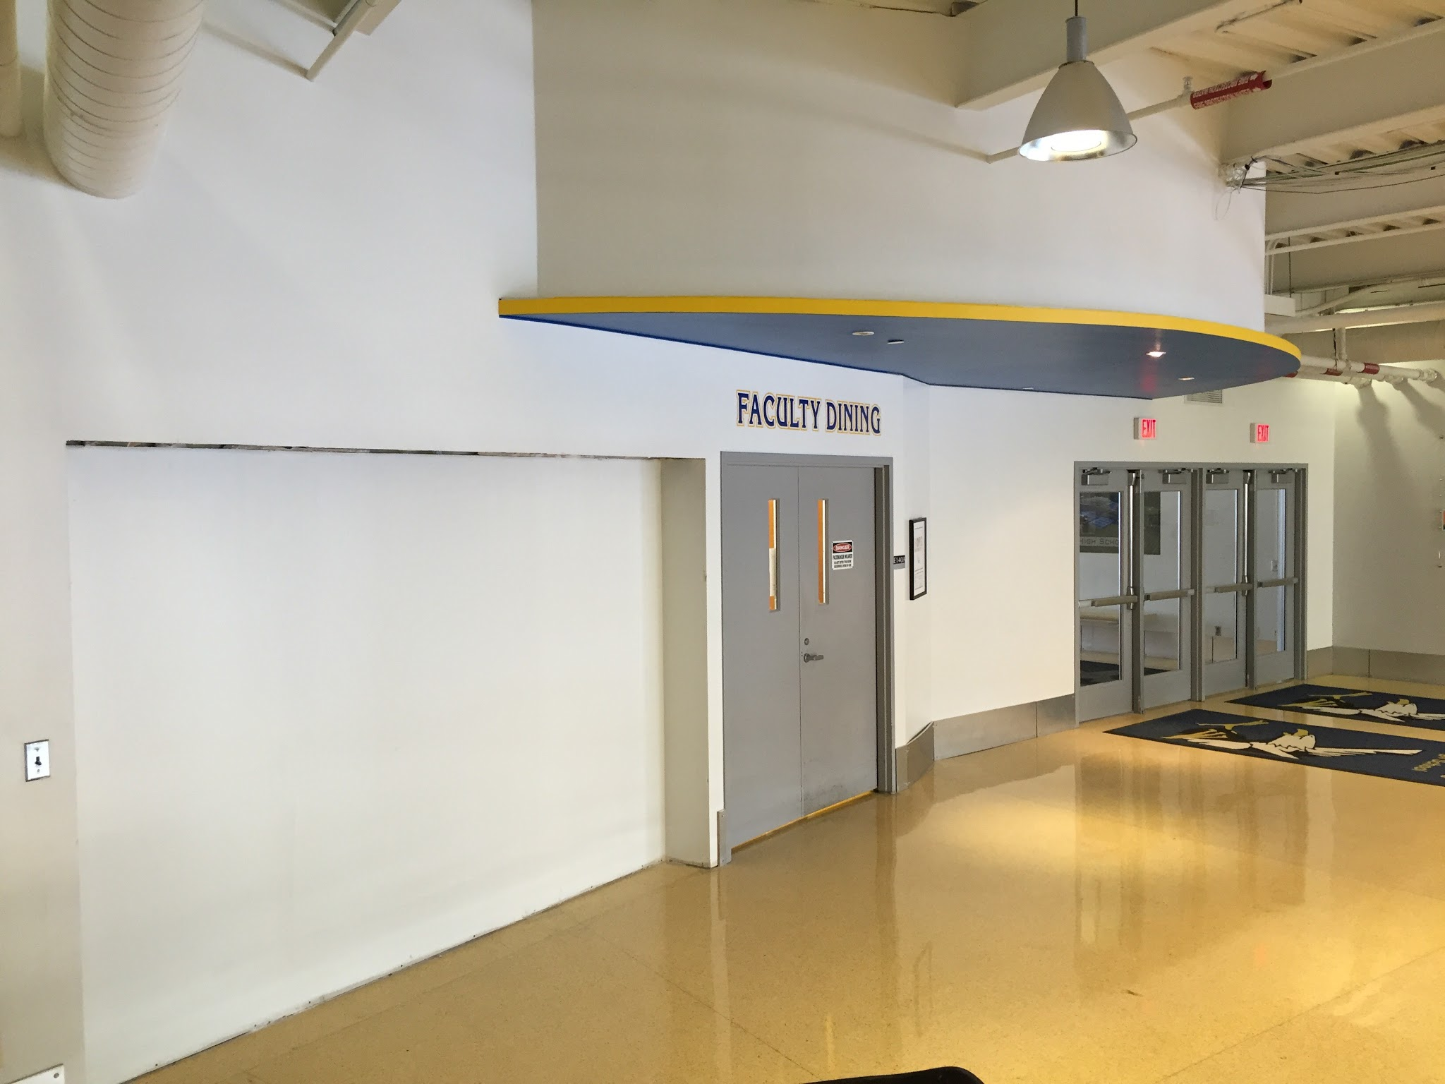
What’s Going On ?
Have you noticed that newly renovated open area in the commons near the front entrance?
That area is being prepped for a school-wide art project that YOU are invited to be a part of!
The form of art to fill this space is referred to as object art.

Slide 3
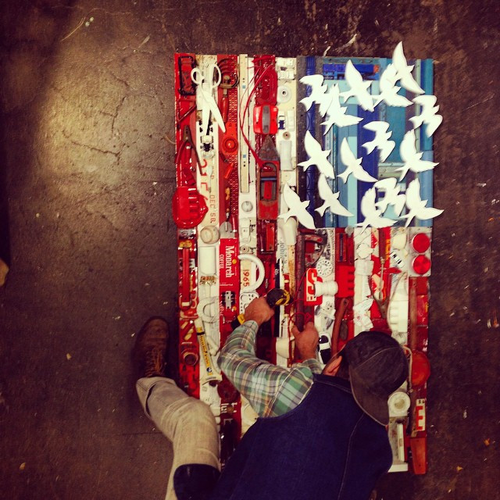
What’s Object Art ?
It’s a larger art piece that is made out of several smaller objects.

Slide 4
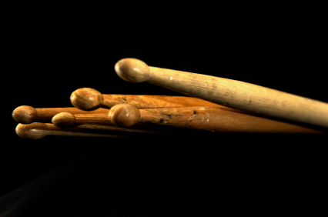
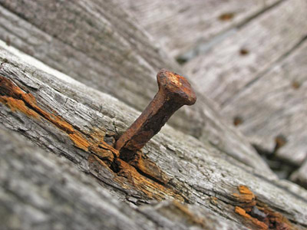
Pride
We’re asking each advisory to THINK OF and DONATE objects that they feel represent PRIDE !
What KIND of pride ? That’s entirely up to YOU and YOUR ADVISORY to decide !
You might be asked however to explain how your donated object represents pride (the story behind the donated object or objects)

Slide 5
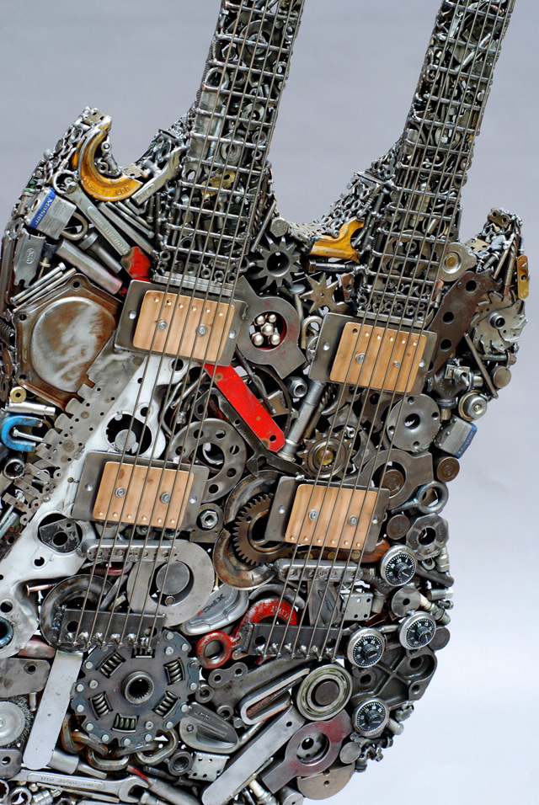
Leave Your Mark
ALL of these donated objects will be collected and turned into a piece of ART
This art piece will be permanently displayed within the commons
What a great way to illustrate how YOUR story (told through your object and interpretation of pride) can fit into the bigger story that is SANDBURG high school and the LEGACY we all leave here.

Slide 6
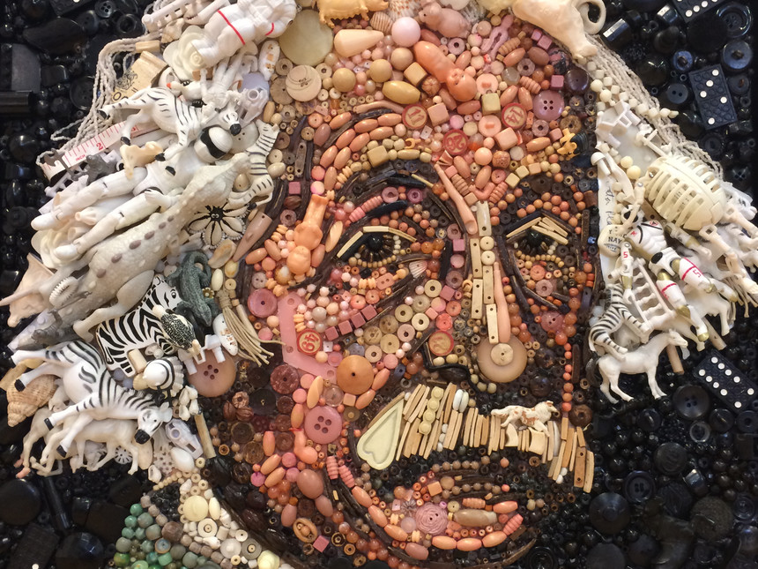
Specifics:
Objects must fit into the bag given to your advisory teacher(s).
Objects within reason: no glass, weapons, or inappropriate images.
Objects must be donated no later than Monday, Feb 29th.
Please submit a brief description with each object as to how you believe the object represents pride.

